Slide 1
Control Flow
Computer Engineering Department
Java Course
Assoc. Prof. Dr. Ahmet Sayar
Kocaeli University - Fall 2019

Slide 2
IF Statement

Slide 3
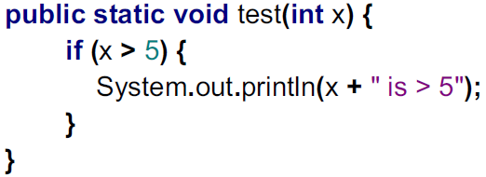
If Statement
if (CONDITION) {
STATEMENTS
} else {
STATEMENTS
}

Slide 4
Comparison operators
x > y: x is greater than y
x < y: x is less than y
x >= y: x is greater than or equal to x
x <= y: x is less than or equal to y
x == y: x equals y
( equality: ==, assignment: = )

Slide 5
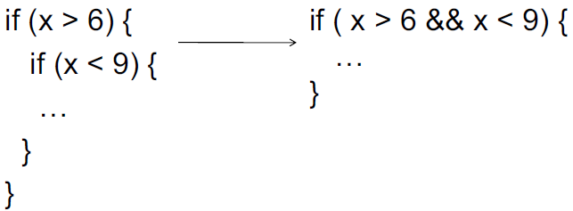
Boolean operators
&&: logical AND
||: logical OR

Slide 6
Multibranch if-else Statements
syntax
if (Boolean_Expression_1)
Statement_1
else if (Boolean_Expression_2)
Statement_2
else if (Boolean_Expression_3)
Statement_3
else if …
else
Default_Statement

Slide 7
Compound Boolean Expressions
Boolean expressions can be combined using the “and” (&&) operator.
example
if ((score > 0) && (score <= 100))
...
not allowed
if (0 < score <= 100)
...

Slide 8
Negating a Boolean Expression
A boolean expression can be negated using the “not” (!) operator.
syntax
!(Boolean_Expression)
example
(a || b) && !(a && b)
which is the exclusive or

Slide 9
Nested Statements
An if-else statement can contain any sort of statement within it.
In particular, it can contain another if-else statement.
An if-else may be nested within the “if” part.
An if-else may be nested within the “else” part.
An if-else may be nested within both parts.

Slide 10
Nested Statements, cont.
syntax
if (Boolean_Expression_1)
if (Boolean_Expression_2)
Statement_1)
else
Statement_2)
else
if (Boolean_Expression_3)
Statement_3)
else
Statement_4);

Slide 11
The switch Statement
The switch statement is a multiway branch that makes a decision based on an integral (integer or character) expression.
The switch statement begins with the keyword switch followed by an integral expression in parentheses and called the controlling expression.

Slide 12
The switch Statement, cont.
The action associated with a matching case label is executed.
If no match is found, the case labeled default is executed.
The default case is optional, but recommended, even if it simply prints a message.
Repeated case labels are not allowed.

Slide 13
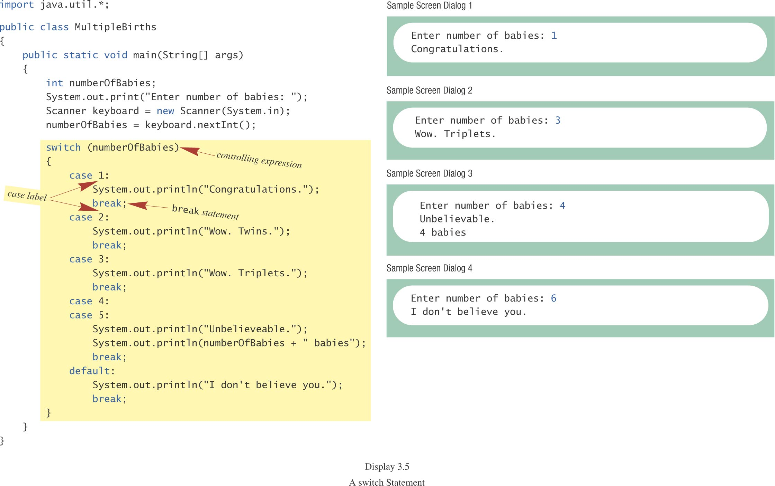
The switch Statement, cont.

Slide 14
Switch Example
int i=1; // outputs for differing values of i : (0, 1, 2, 3)
switch (i) {
case 0:
System.out.println("zero");
break;
case 1:
System.out.println("one");
case 2:
System.out.println("two");
default:
System.out.println("default");
}
Notes:
i=0 -> zero
i=1 -> one two default
i=2 -> two default
i=3 -> default

Slide 15
Switch Variable Types
We can apply Switch just on data type compatible short, Short, byte, Byte, int, Integer, char, Character or enum type.
Evaluating String variables with a switch statement have been implemented in Java SE 7, and hence it only works in java 7
See your Java version in NetBeans
Tools – Java Platforms

Slide 16
The Conditional Operator
if (n1 > n2)
max = n1;
else
max = n2;
can be written as
max = (n1 > n2) ? n1 : n2;
The ? and : together are call the conditional operator or ternary operator.

Slide 17
LOOPS

Slide 18
Java Loop Statements: Outline
The while Statement
The do-while Statement
The for Statement

Slide 19
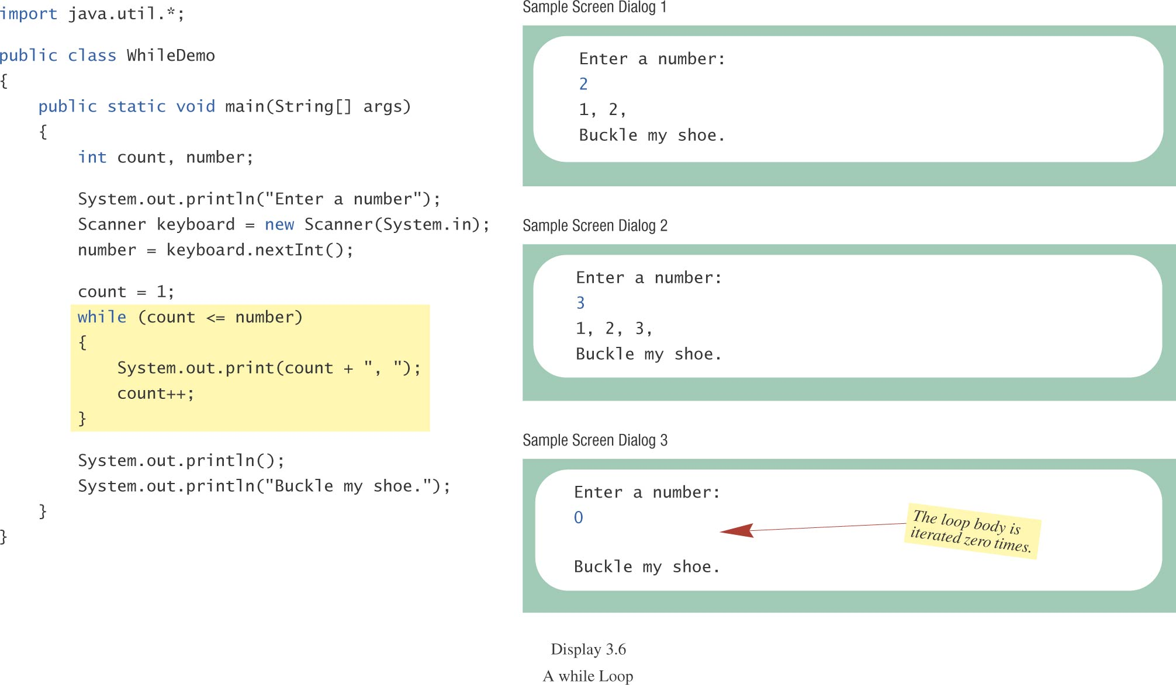
the while Statement, cont.

Slide 20
The do-while Statement
Also called a do-while loop
Similar to a while statement, except that the loop body is executed at least once
syntax
do
Body_Statement
while (Boolean_Expression);
don’t forget the semicolon!
Notes:
do
System.out.println("1");
System.out.println("2");
while(true);
//Hata!!!!
do
System.out.println("1");
while(true);
// sonsuz 1 basar

Slide 21
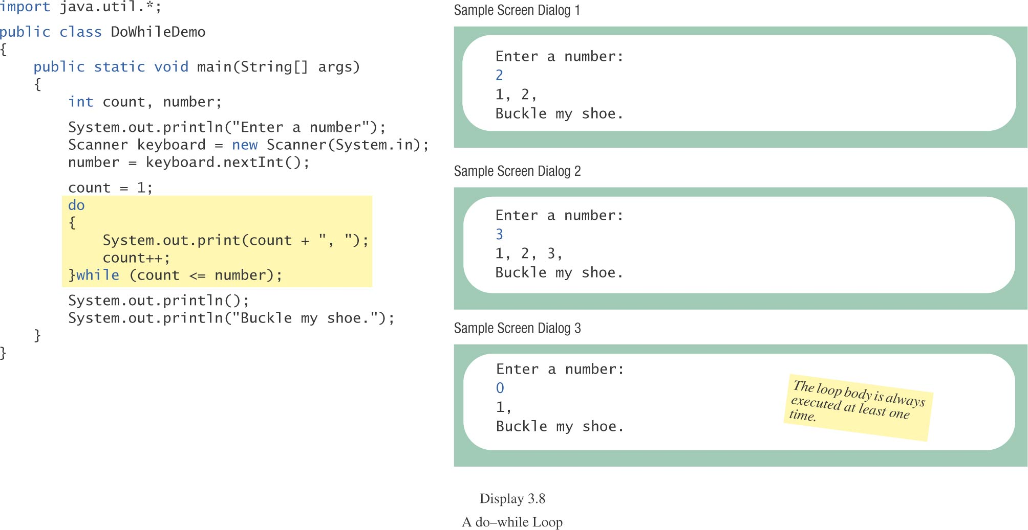
The do-while Statement, cont.

Slide 22
The for Statement
A for statement executes the body of a loop a fixed number of times.
Example
for (count = 1; count < 3; count++)
System.out.println(count);
System.out.println(“Done”);
//watch out the usage of ‘{‘ and ‘}’

Slide 23
Multiple Initialization, etc.
example
for (n = 1, p = 1; n < 10; n++)
p = p * n ;
Only one boolean expression is allowed, but it can consist of &&s, ||s, and !s.
Multiple update actions are allowed, too.
for (n = 1, p = 1; n < 10; n++, p=p * n)
rarely used

Slide 24
Example
for (n = 20, p = 1; p < n; n++, p=p * 5){
System.out.println("n: " +n+" "+"p: " +p);
}
What is the output of this code?
Notes:
n: 20 p: 1
n: 21 p: 5

Slide 25
The Empty for Statement
What is printed by
int product = 1, number;
for (number = 1; number <= 10; number++);
product = product * number;
System.out.println(product);?
The last semicolon in
for (number = 1; number <= 10; number++);
produces an empty for statement.
for(;;){
System.out.println(“infinite loop");
}
Notes:
11

Slide 26
Choosing a Loop Statement
If you know how many times the loop will be iterated, use a for loop.
If you don’t know how many times the loop will be iterated, but
it could be zero, use a while loop
it will be at least once, use a do-while loop.
Generally, a while loop is a safe choice.

Slide 27
The break Statement in Loops
A break statement can be used to end a loop immediately.
The break statement ends only the innermost loop or switch statement that contains the break statement.
break statements make loops more difficult to understand.
Use break statements sparingly (if ever).

Slide 28
Example
for(int i=0; i<2; i++){
System.out.println("i: "+i);
for (int j = 0; j < 3; j++) {
System.out.println("j: "+j);
if (j==1) {
break;
}
}
}
Notes:
i: 0
j: 0
j: 1
i: 1
j: 0
j: 1

Slide 29
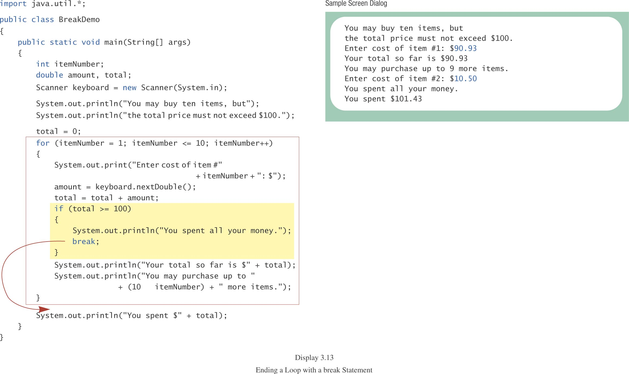
The break Statement in Loops, cont.

Slide 30
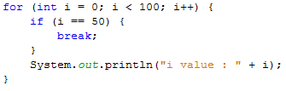
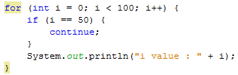
Branching Statements

Slide 31
The exit Method
Sometimes a situation arises that makes continuing the program pointless.
A program can be terminated normally by
System.exit(0).
Example
if (numberOfWinners == 0)
{
System.out.println(“/ by 0”);
System.exit(0);
}

Slide 32
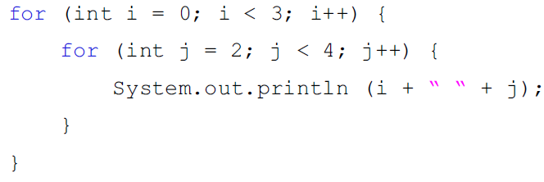
Embedded Loops

Slide 33
Ending a Loop
If the number of iterations is known before the loop starts, the loop is called a count-controlled loop.
use a for loop.
Asking the user before each iteration if it is time to end the loop is called the ask-before-iterating technique.
appropriate for a small number of iterations
Use a while loop or a do-while loop.

Slide 34
Ending a Loop, cont.
For large input lists, a sentinel value can be used to signal the end of the list.
The sentinel value must be different from all the other possible inputs.
A negative number following a long list of nonnegative exam scores could be suitable.
90
0
10
-1
Notes:
Örnek yaptır

Slide 35
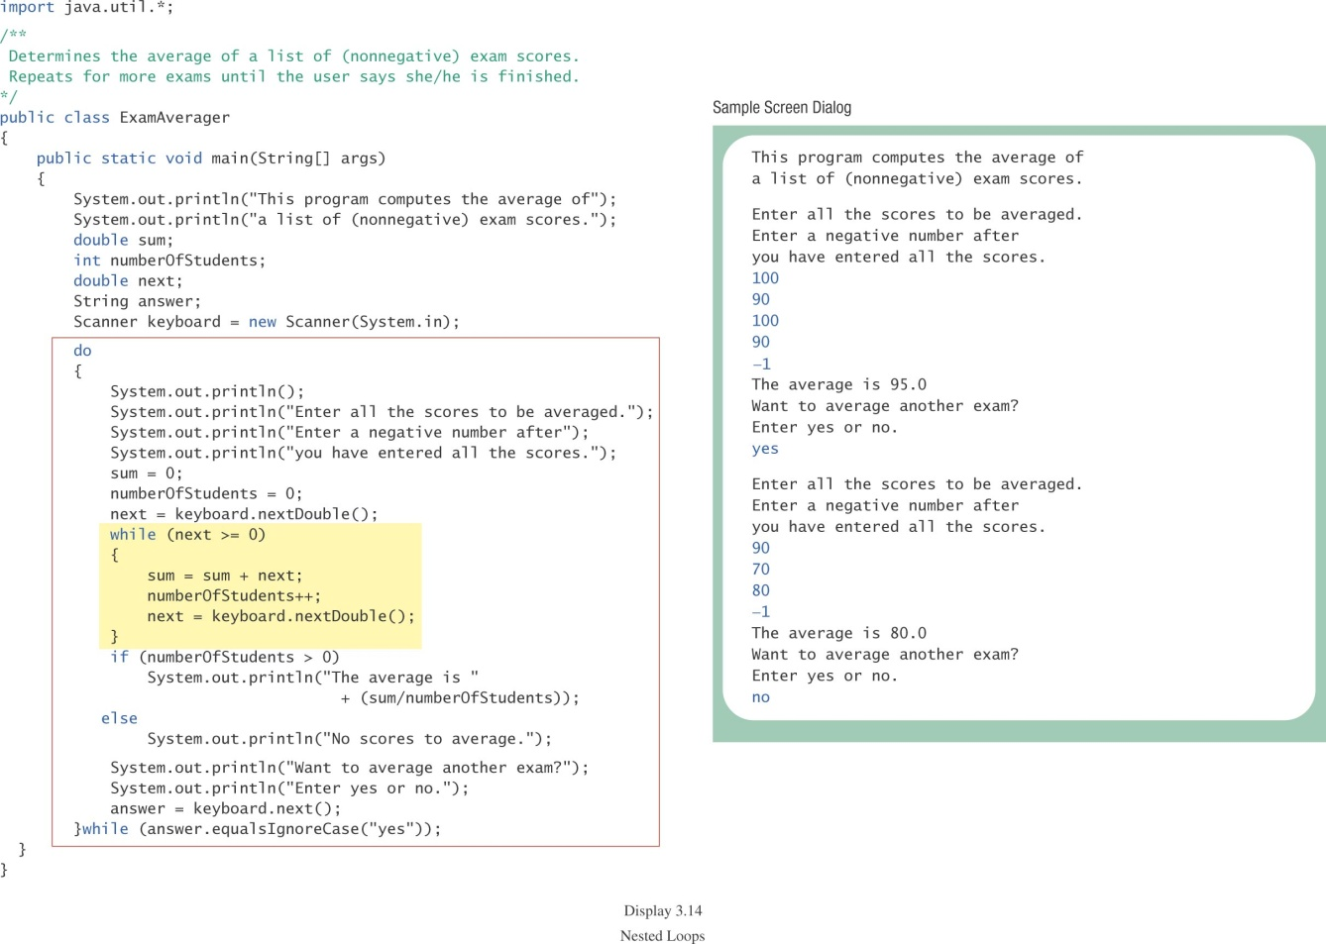
Example: class ExamAverager

Slide 36
Naming Boolean Variables
Choose names such as isPositive or systemsAreOk.
Avoid names such as numberSign or systemStatus.

Slide 37
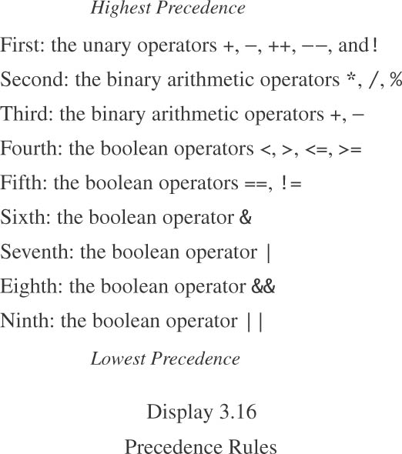
Precedence Rules in Boolean Expressions

Slide 38
Precedence Rules, cont.
In what order are the operations performed?
score < min/2 - 10 || score > 90
score < (min/2) - 10 || score > 90
score < ((min/2) - 10) || score > 90
(score < ((min/2) - 10)) || score > 90
(score < ((min/2) - 10)) || (score > 90)

